Slide 1
Copula-based Sensitivity Analysis for Multi-Treatment Causal Inference with Unobserved Confounding
Alexander Franks
October 22, 2021
University of California, Santa Barbara

Slide 2
Multi-Treatment Inference
Goal: assess the causal effect of multiple treatments applied simultaneously in an observational context
Genome Wide Association Studies (GWAS)
What is the effect of an actor on movie revenue
Can possibly leverage correlation between treatments to control for potential unmeasured confounders.
Many concurrent estimands (e.g. effect of each gene)
Renewed interest in causal community due to Wang and Blei, 2019.

Slide 3
Multi-Treatment Inference: Setup
Outcomes Y (scalar)
Treatments T (k-vector)
Unmeasured confounders U (m-vector)

Slide 4
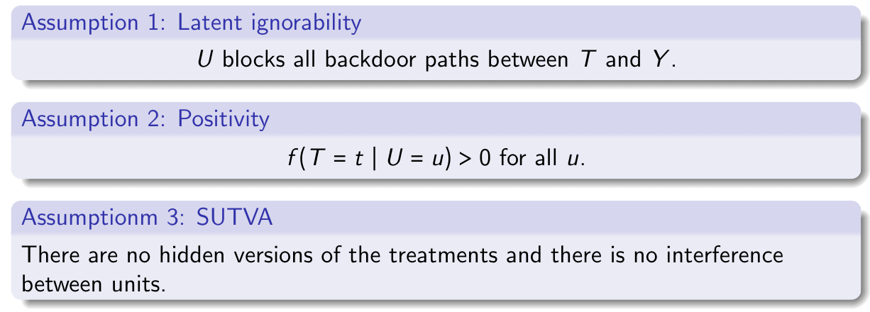
Assumptions

Slide 5
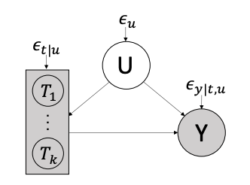
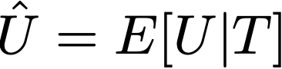
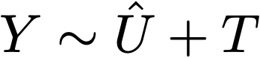
“The Deconfounder” Approach (Wang and Blei, 2019)
Fit a factor model to infer substitute confounders:
“Correct for” bias by including proxy confounder to debias treatment effect estimates:
Assume U is pinpointed by T as k goes to infinity

Slide 6
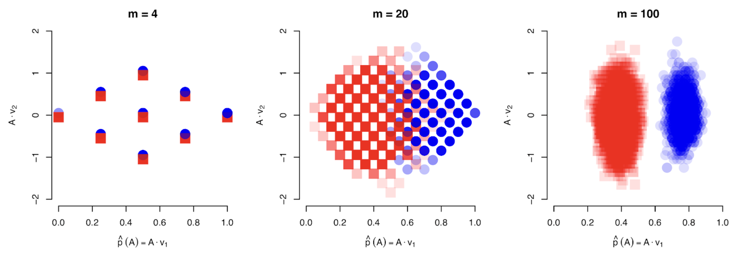
Some problems with “The Deconfounder”
Lack of general nonparametric identification (D’Amour, 2019a,b)
Counterexamples to theoretical results (Ogburn, 2020)
“The Deconfounder” does not outperform naïve regression (Grimmer, 2020)

Slide 7
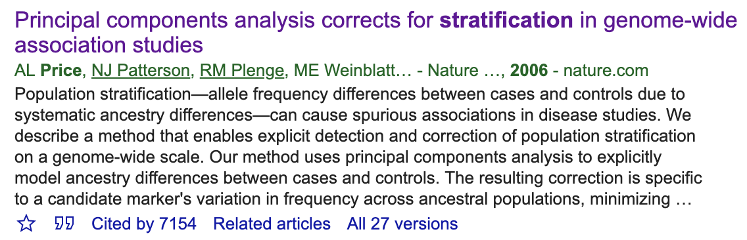
Methods of this type appear across science, and are standard procedure (e.g., Price et al 2006 in GWAS).
This paper finally brings them under the causal microscope.

Slide 8
This talk
Reconcile intuition and practical success with negative theoretical results
Flexible and interpretable sensitivity analysis for multi-treatment inference
Some theoretical insights about the what might be gained in multi-treatment inference

Slide 9
The Role of Sensitivity Analysis
Relax unverifiable identifying assumptions
Readers can assess claims more precisely
Unique challenges in the multiple treatment setting which require careful consideration

Slide 10
Setup
Outcomes Y (scalar)
Treatments T (k-vector),
Confounders U (m-vector)
Use the do-calculus framework (Pearl, 2009)
do operator indicates the density of y in the population in which we intervened to assign t

Slide 11
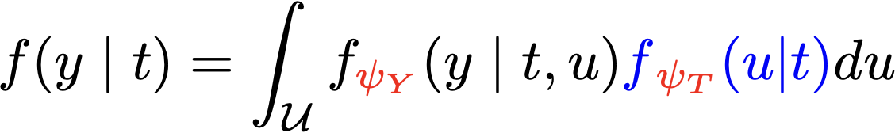
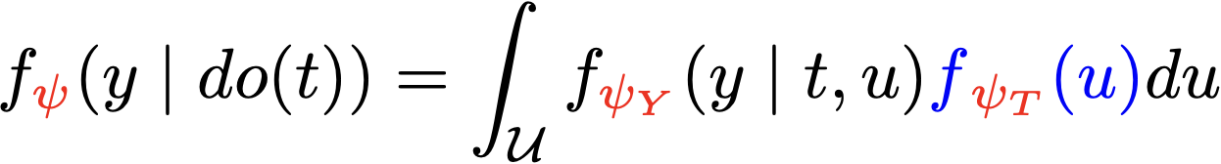

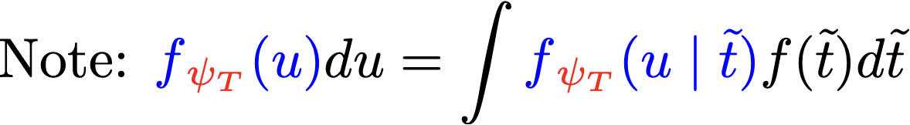
Observed and Intervention Densities
Observed:
Intervention:
are sensitivity parameters

Slide 12
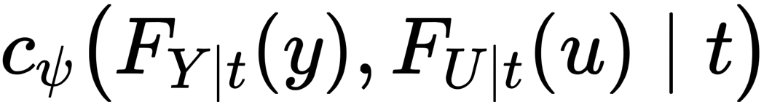


Copula Approach to Multi-Treatment Sensitivity
is the conditional copula which characterizes the dependence between Y and U given T.
might be identified (up to an equivalence class) with multiple treatments (e.g. a latent factor model)
remains unidentified

Slide 13
Motivating Example: Analysis of Mouse Obesity
Explore the effect of 17 gene expression values on mouse weight (Miao et al 2020)
Likely confounded due to batch effects and unmeasured phenotypes
Gene expression are the “treatments” and weight is the outcome
Model treatments and outcomes as Gaussian
Correlation between expression levels (”treatments”) is indicative of potential confounding

Slide 14
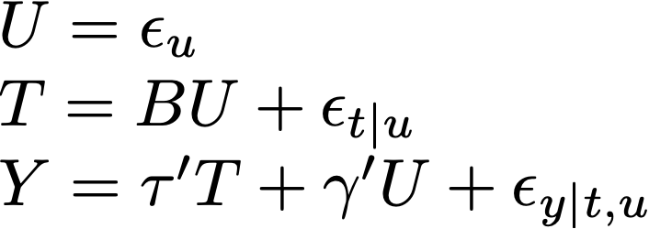
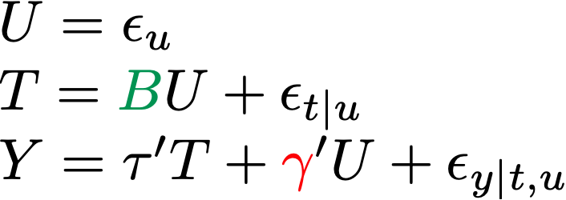
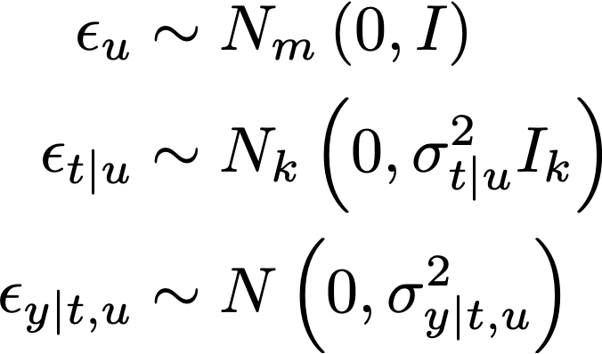
Building Intuition: The Linear Gaussian Model

Slide 15
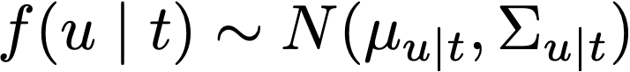
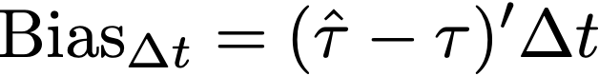

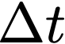
The Linear Gaussian Model
In this model:
is identifiable (up to scale / rotation)
Sensitivity analysis:
Consider confounding bias of naïve estimates as a function of
Bias varies across treatment contrasts,

Slide 16
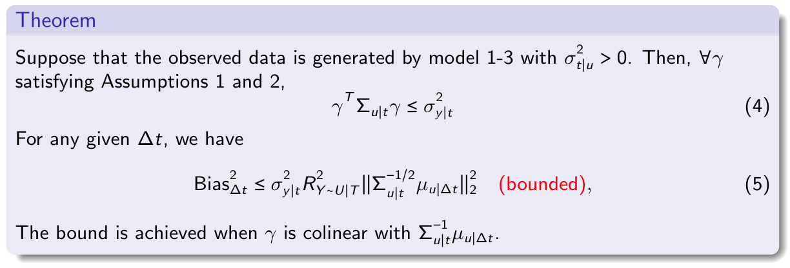
Worst-case bias of naïve estimators
The omitted variable bias is proportional to the scaled difference in confounder means

Slide 17
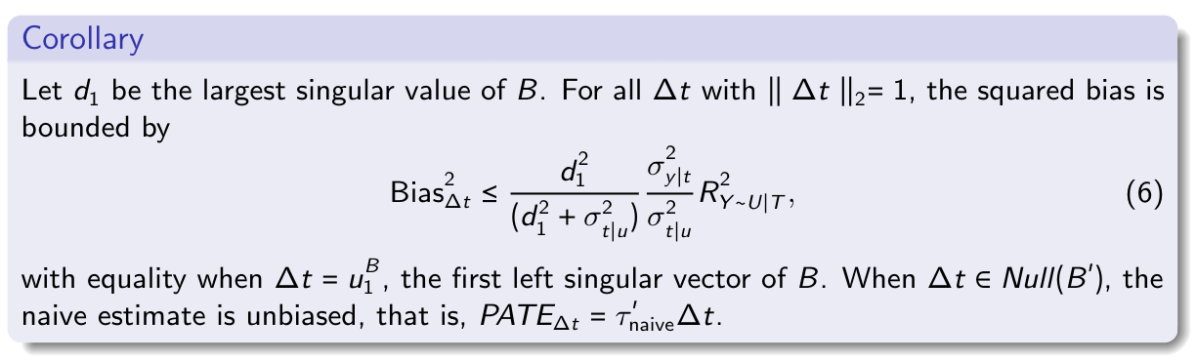
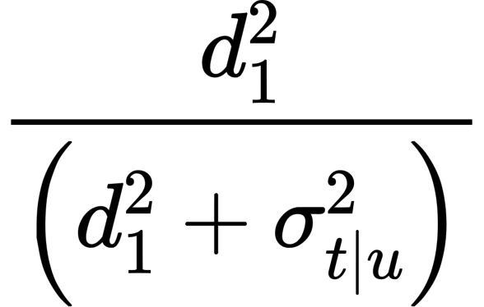
Overall worst-case bias
is the fraction of variance in the first PC of treatments that can be explained by confounding.

Slide 18
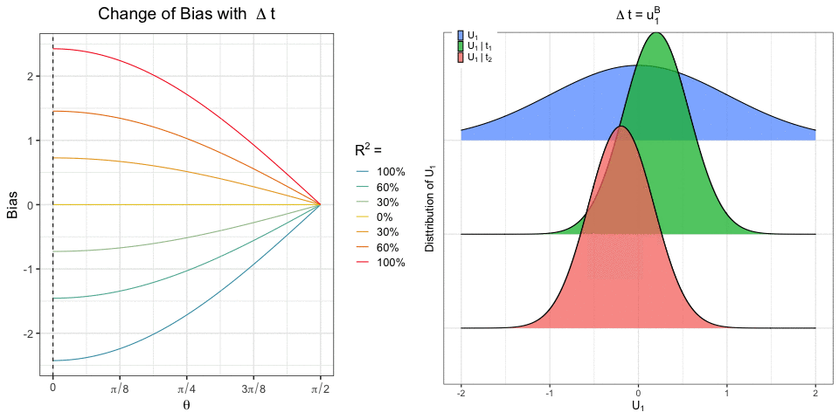
Confounding Bias

Slide 19
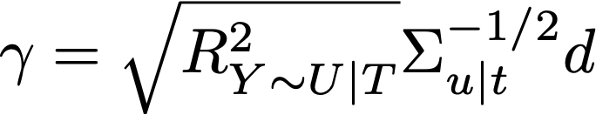
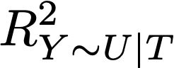
Robustness and Calibration
Sensitivity analysis consists of two parts:
The sensitivity model parameterization
Tools for mapping external assumptions to specific models in the set
Models parameterized by
Default: choose d to maximize bias and reason about .

Slide 20
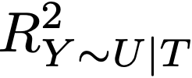
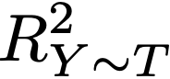
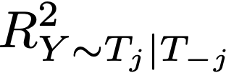
Robustness and Calibration
The robustness value is the smallest value of that negates the sign of the treatment effect.
If no value can change the sign we declare the effect robust to this confounding
Can reason about by robustness by comparing to:
, the observed fraction of variance explained by treatments
the partial fraction of variance explained by some, given others

Slide 21
Analysis of Mouse Obesity
Explore the effect of 17 gene expression values on mouse weight (Miao et al 2020)
Likely confounded due to batch effects and unmeasured phenotypes
Gene expression are the “treatments” and weight is the outcome
Model treatments and outcomes as Gaussian
Correlation between expression levels is indicative of potential confounding

Slide 22
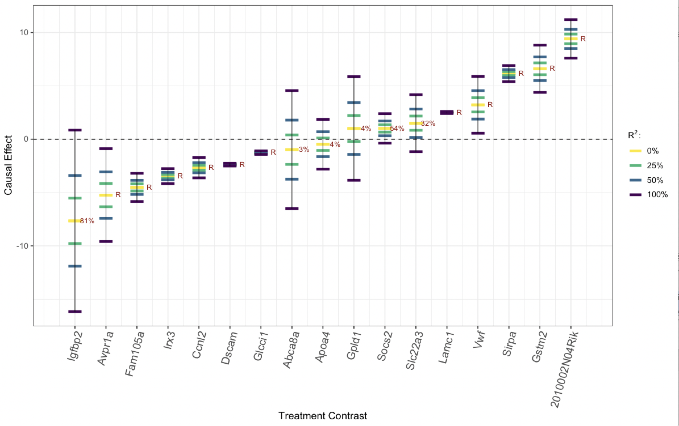

Slide 23
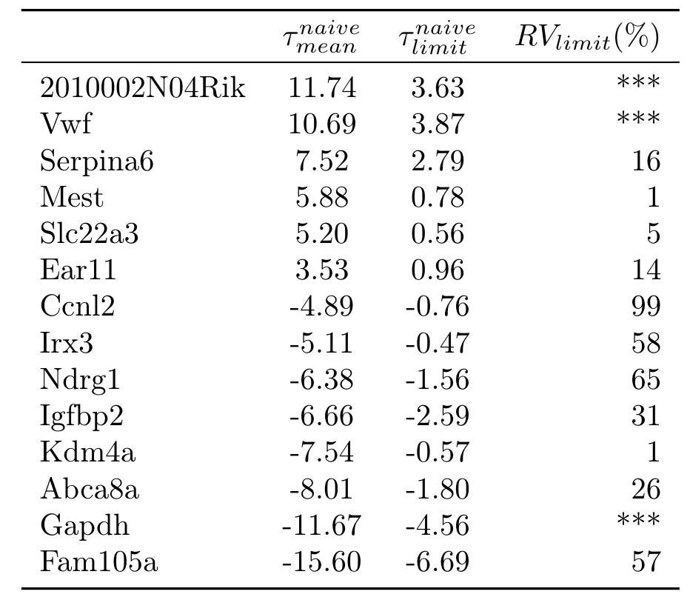

Slide 24
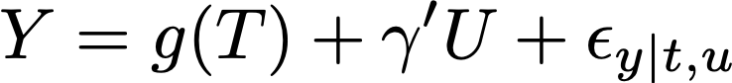
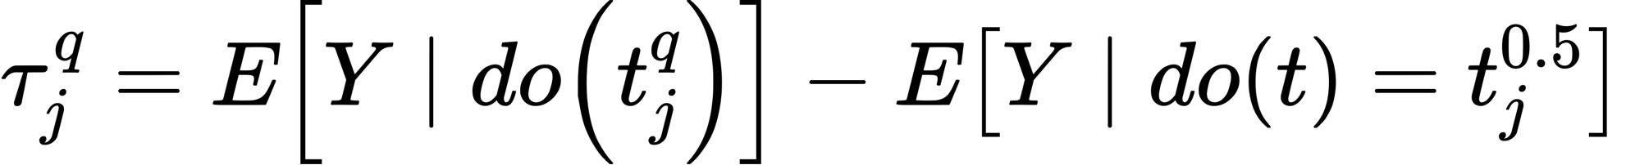
Non-linear models
Model:
Model the outcome given treatments using Bayesian Additive Regression Trees
New estimand:
where is the treatment vector with all genes at their median level except for the jth gene which has it’s level set to the q-th quantile.

Slide 26
Additional Assumptions for Reducing Ignorance
R-squared: what fraction of the outcome variance is due to confounding?
Null controls: specify which set of treatments are known to have no causal impact on the outcome.
Sparsity: the majority of treatments have no effect
Miao et al (2020) propose an identification strategy based on the assumption that at least half of the treatments have no effect (”null treatments”)
Natural to encode these assumptions with prior distributions in a Bayesian framework

Slide 29
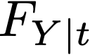
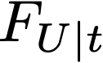
Multi-cause sensitivity in general
is the conditional copula which characterizes the dependence between Y and U given T.
No information in the observed data about this copula
is the CDF of the naïve outcome model
is the CDF of U given T=t. Assumed identifiable from the latent variable model.

Slide 30
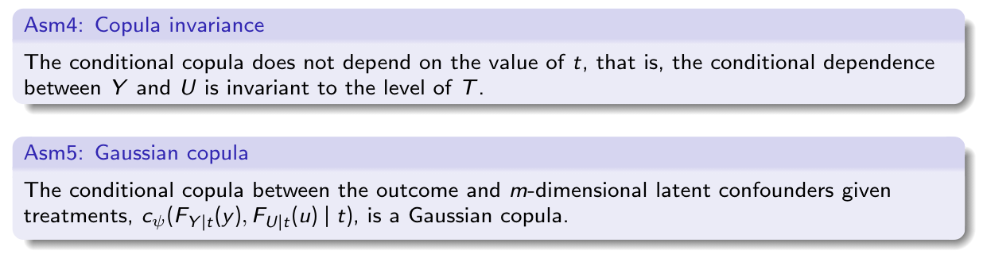
Additional Assumptions

Slide 31
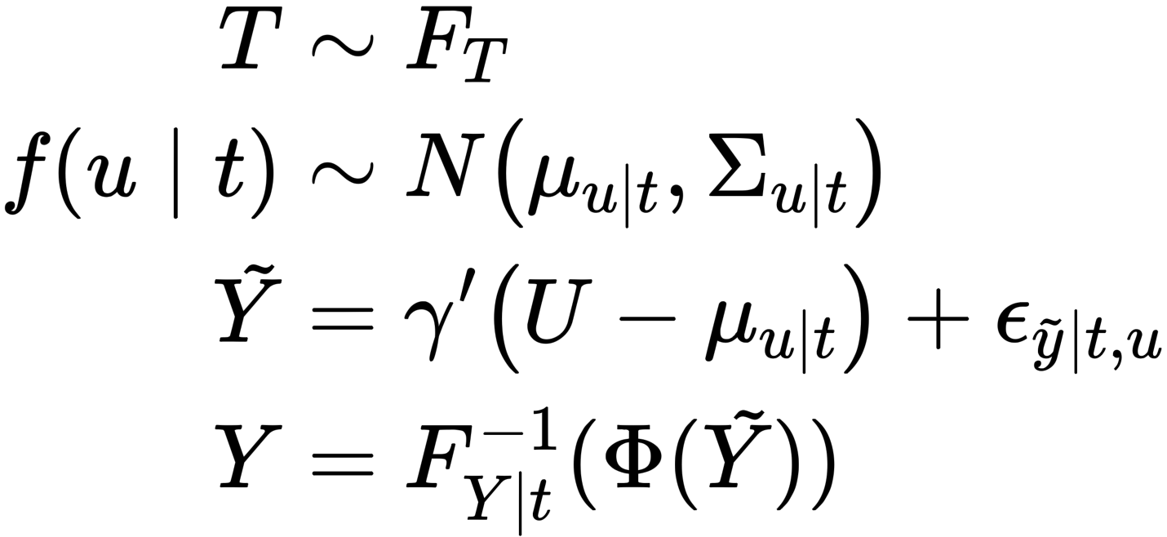
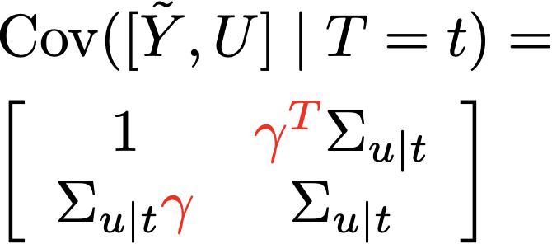
Multi-cause sensitivity in general
Implied Gaussian copula:

Slide 32
Analysis of IMDB movie data
Analysis of TMDB 5000 Move Dataset
Estimate the effect of an actor’s presence on movie revenue (see Wang and Blei, 2018)
Regress log revenue of cast indicators
Explicitly exclude observed covariates in order to validate the sensitivity analysis.
E.g. budget explains 30% of the variance in revenue

Slide 33
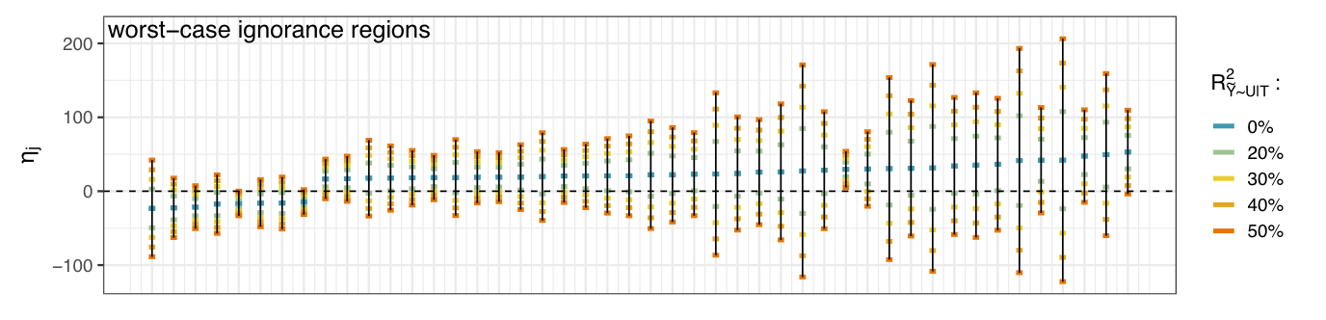


Slide 34
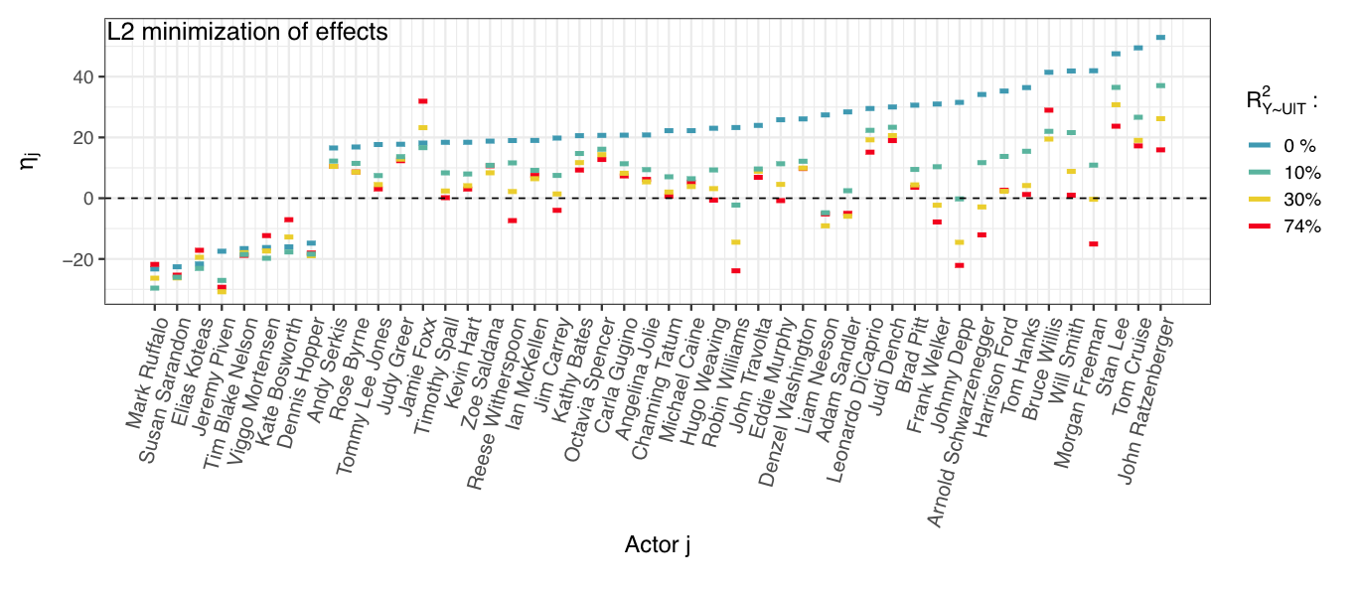
Minimum Norm Effects

Slide 35
Conclusions
If you can identify the distribution of latent confounders given treatments, you get bounded ignorance regions for the causal effects
Sensitivity analysis allows us to relax strong identifying
Explore robustness to different kinds of assumptions (R^2, sparsity, null controls, etc)
Current work on encoding causal assumptions with Bayesian priors

Slide 36
Software and Future Directions
Alternative latent variable models
Interpretation and calibration is the challenge
Bayesian inference for encoding (partially) uncheckable causal assumptions.
Multiple outcomes
R package available at github.com/JiajingZ/CopSens

Slide 37


Thanks!
Jiajing Zheng
UCSB
Alexander D’Amour
Google Research
Reference: Jiajing Zheng, Alexander D’Amour and Alexander Franks, Copula-based Sensitivity Analysis for Multi-Treatment Causal Inference with Unobserved Confounding. Arxiv: https://arxiv.org/abs/2102.09412
R package available at github.com/JiajingZ/CopSens

Slide 38
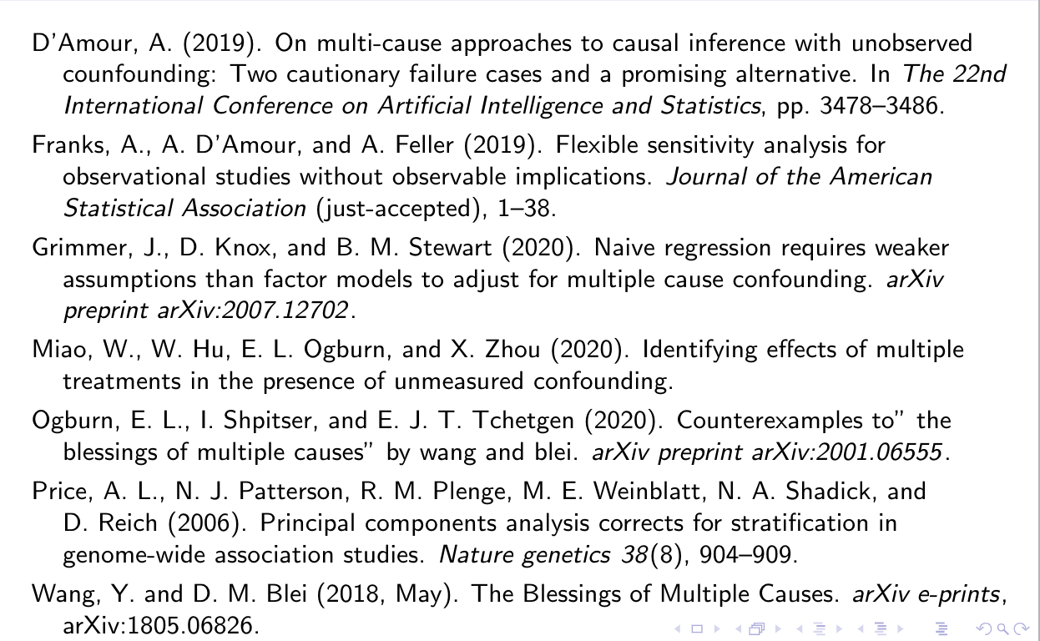
References

Slide 39
Binary outcomes and/or binary treatments
For binary outcomes, focus on the risk ratio:
For non-Gaussian treatments we use variational autoencoder
Neural network latent variable model where holds approximately

Slide 40
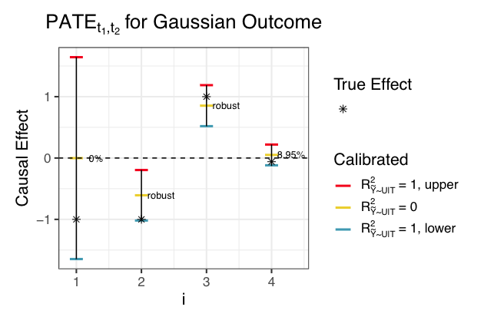
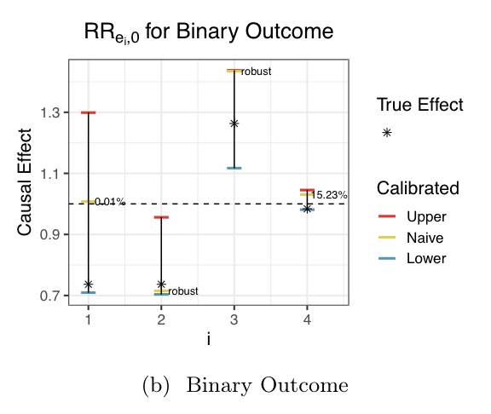

Slide 41
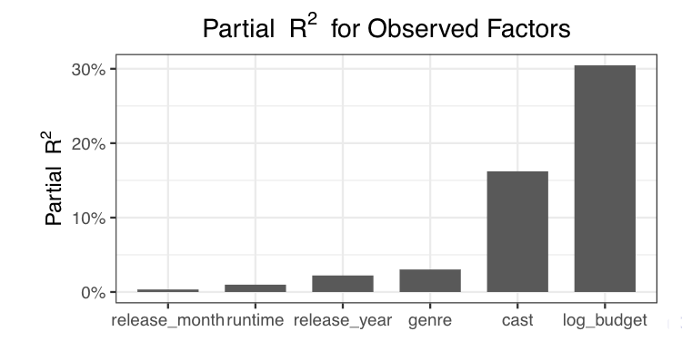
Observable Partial R-squareds for IMDB example

